Slide 1
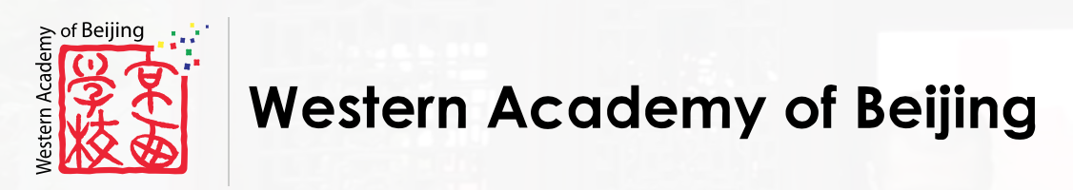
WAB Tiger Commerce
WAB DAD| Parent Link Project 2018/19
Jim James
jimajames@icloud.com
Issue: 12.09.2018 v5

Slide 2
1. Current situation
Parent Link sells WAB Tiger merchandise at one shop.
The Tiger Den is located in WAB’s Elementary school.
Volunteers run the shop.
Shopping hours are limited.
Tiger plays valuable role in the community
Legal and financial aspects held by WAB

Slide 3
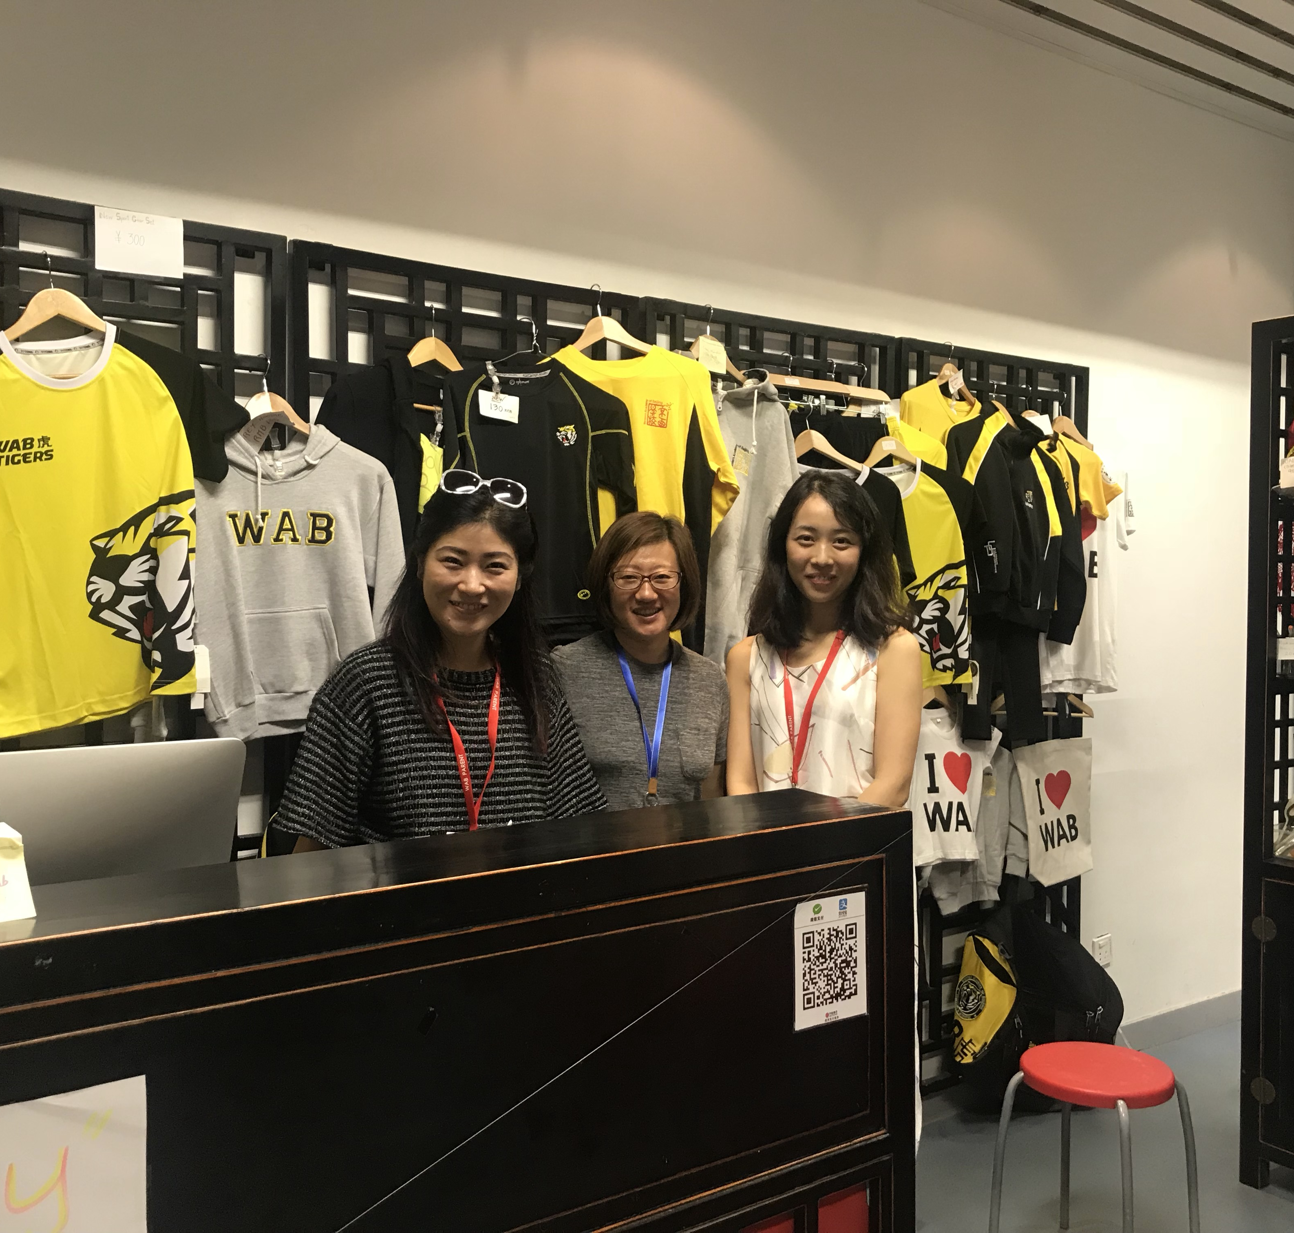
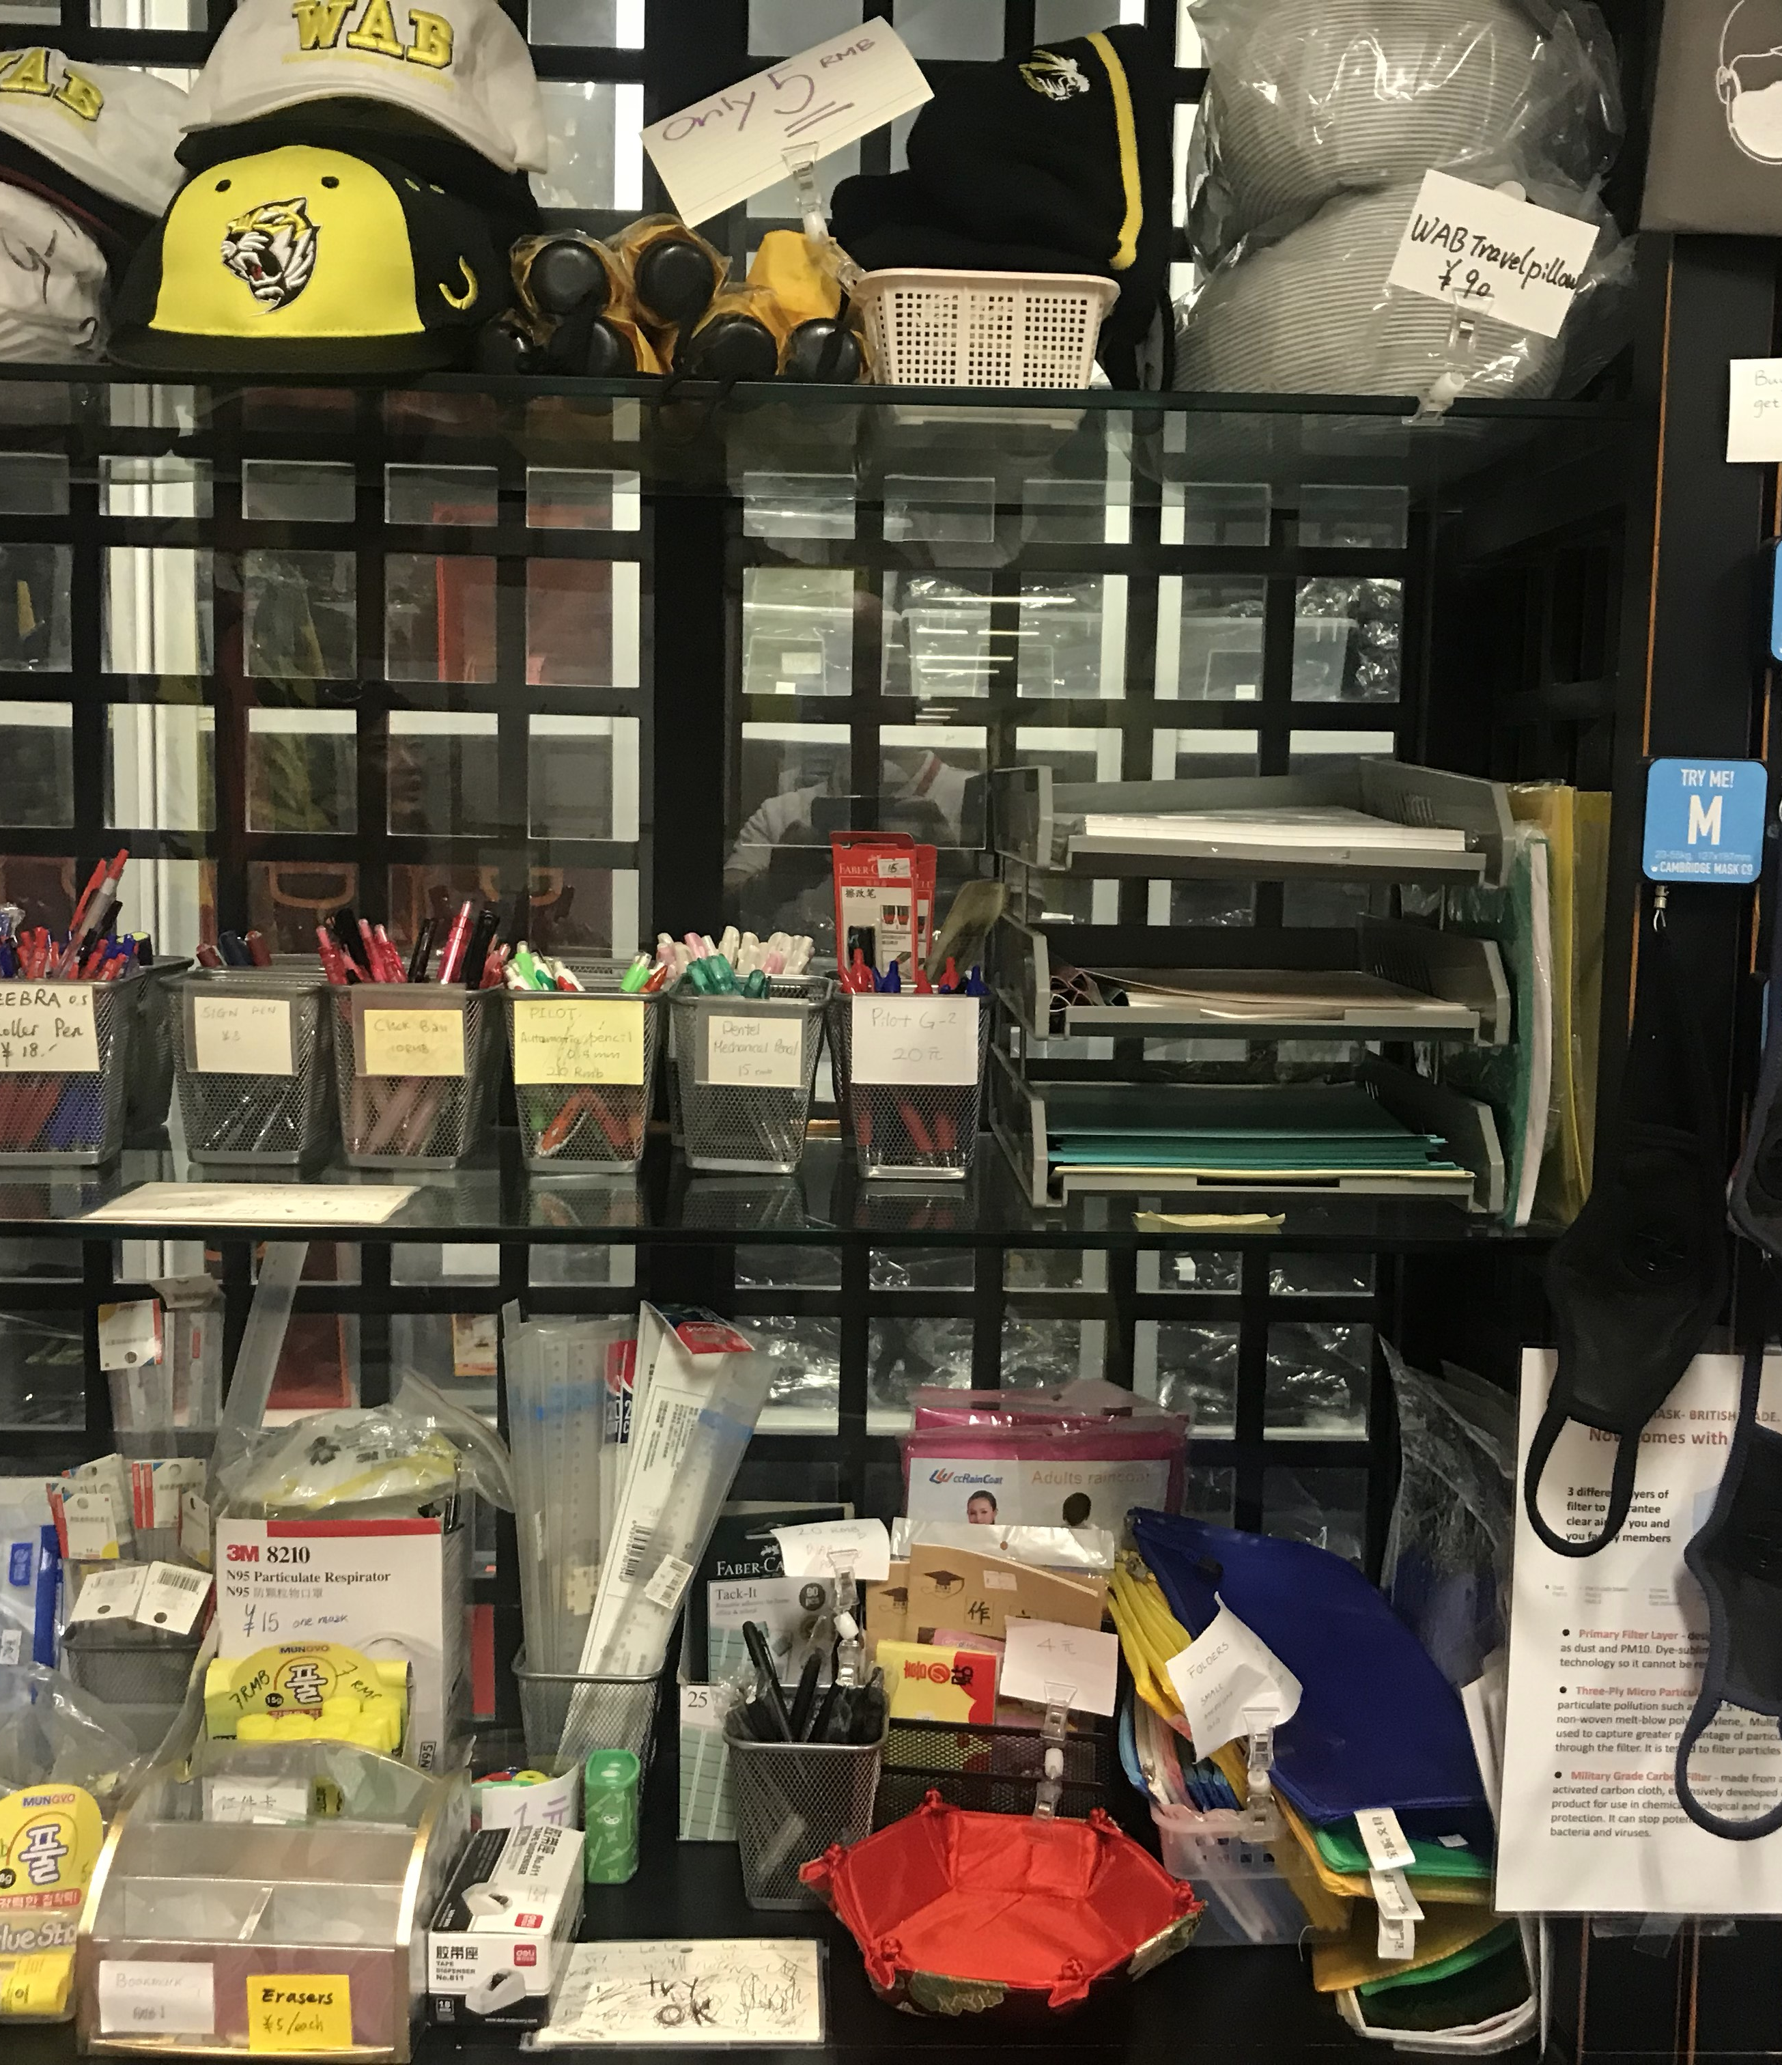
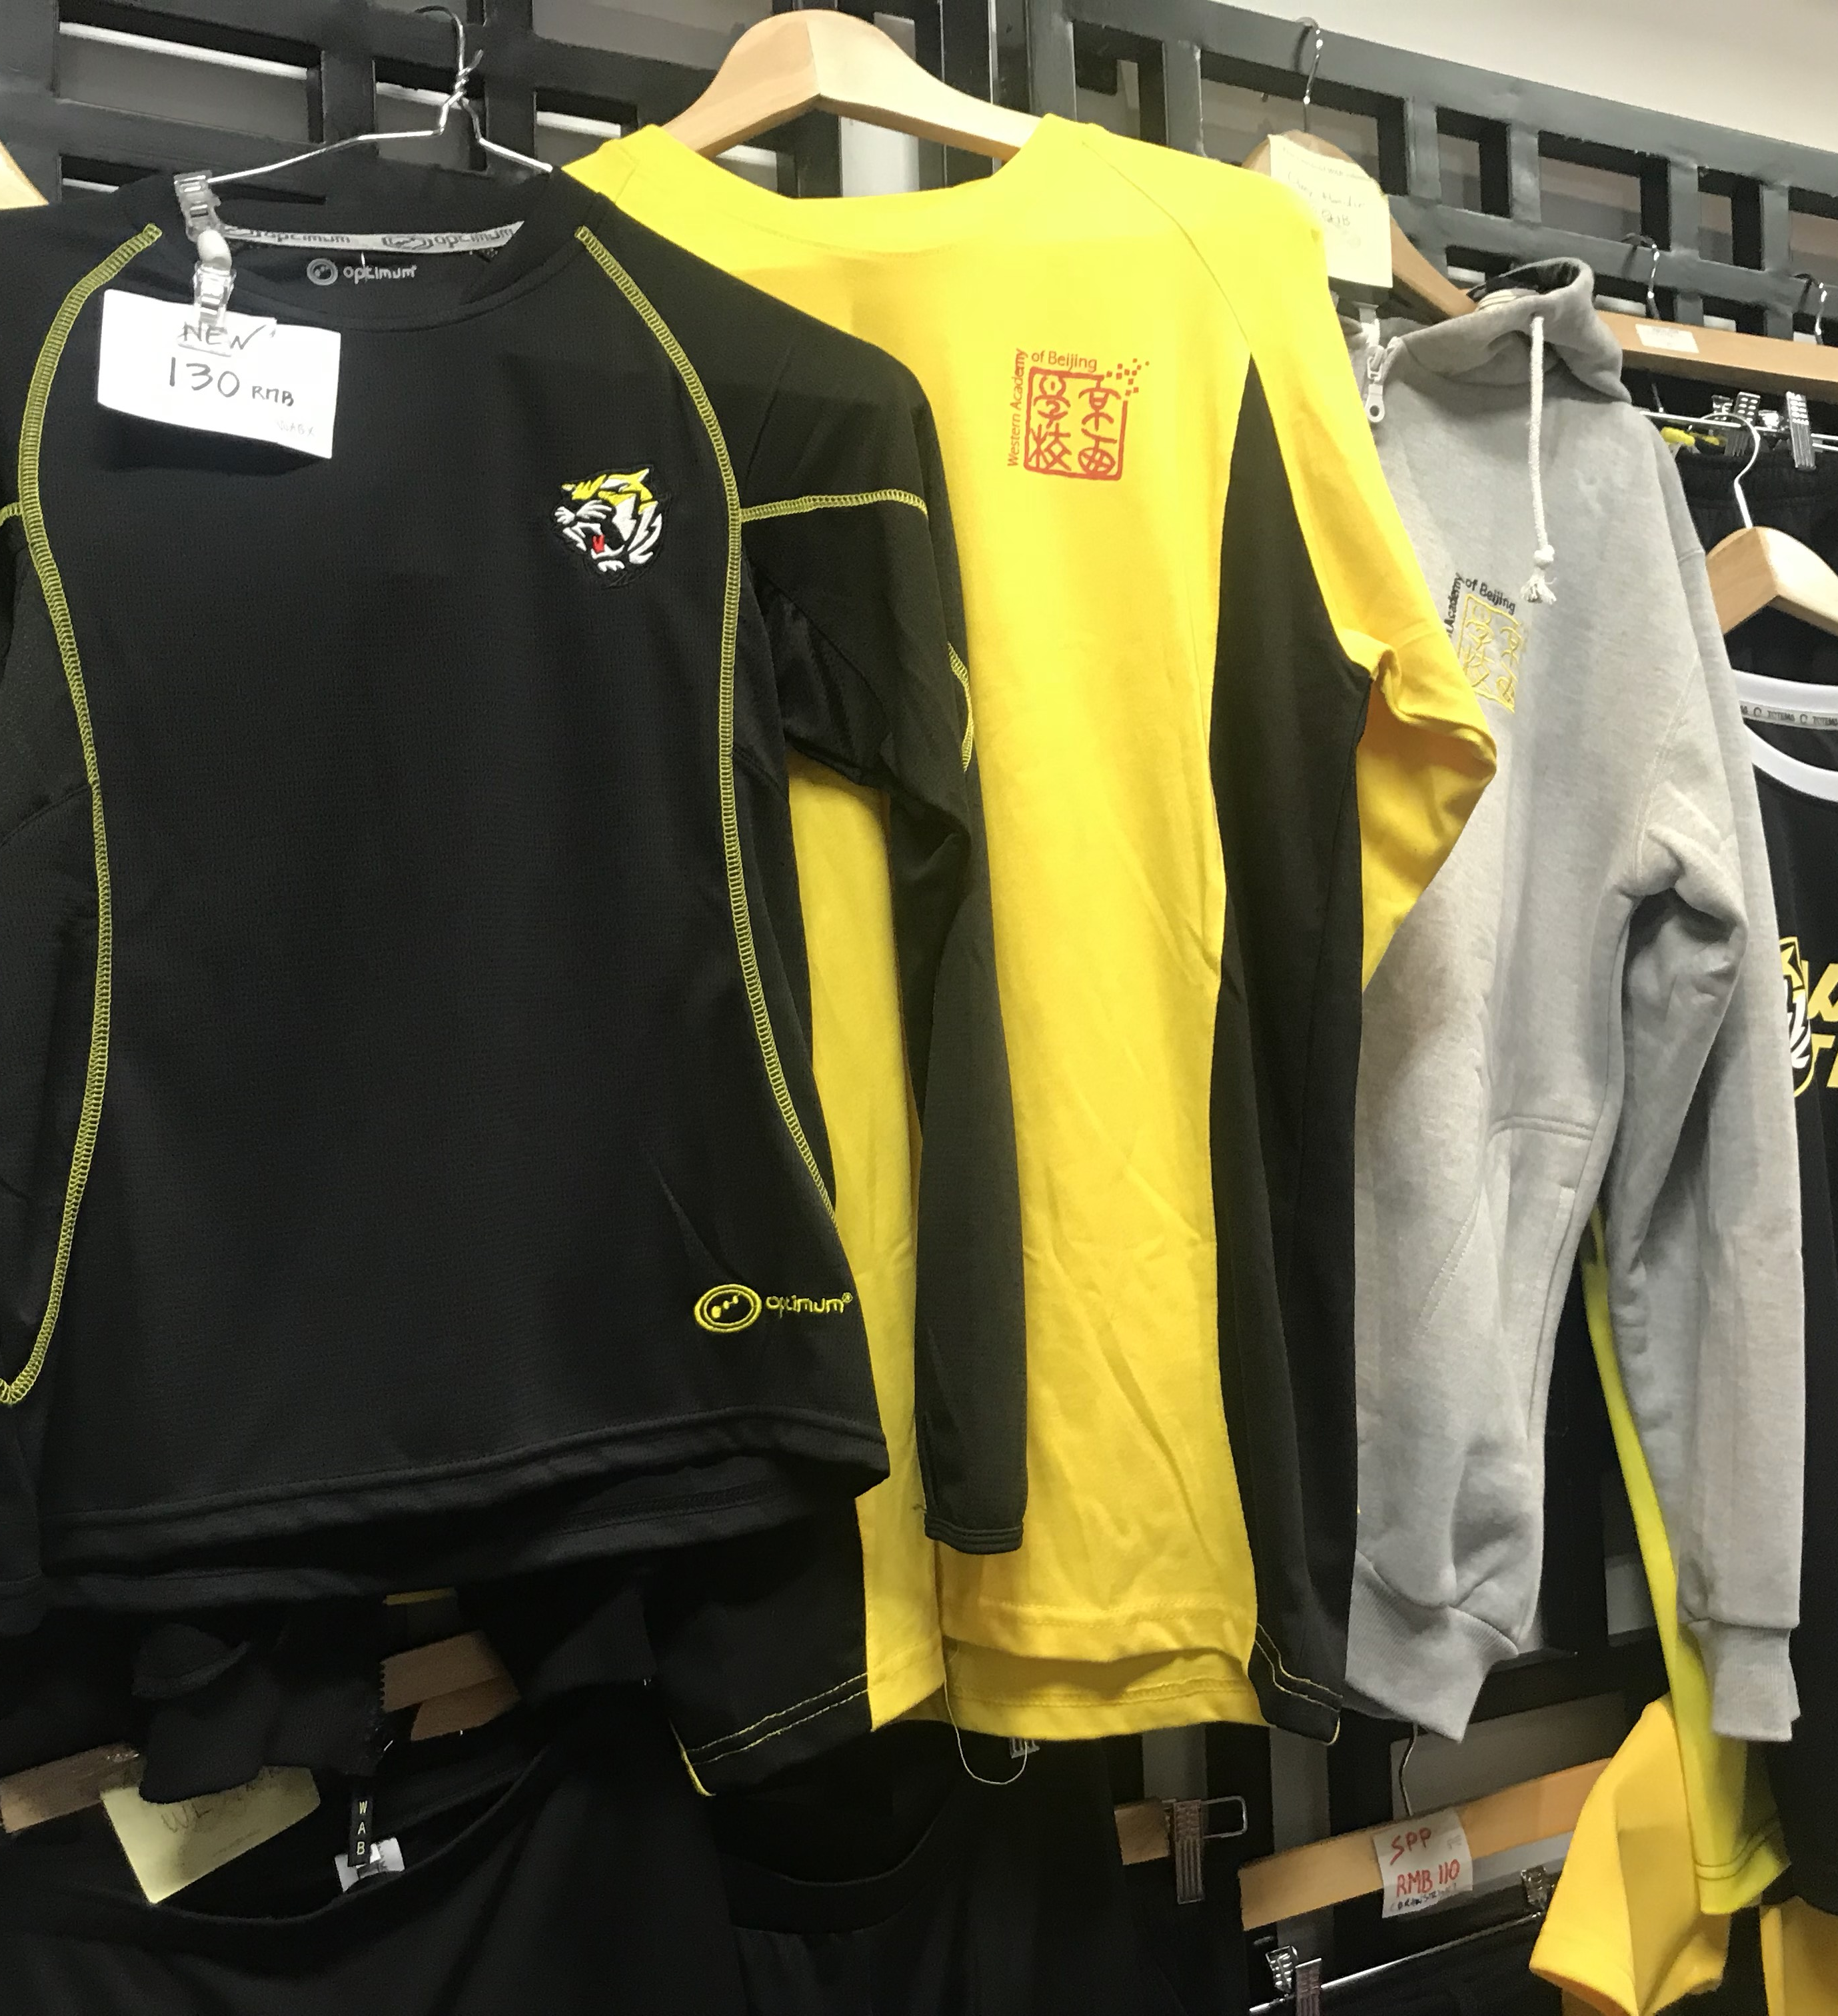
The Tiger Den: WAB Tiger merchandise shop

Slide 4
2. Objectives
Offer WAB Tiger merchandise to customers 24/7
Increase WAB Tiger merchandise sales contribution to Parent Link
Reduce the work load on the shop volunteers
Enable WAB Alumnus to continue to support WAB
Reduce costs of WAB Tiger merchandise by increasing volume
Develop new WAB merchandise

Slide 5
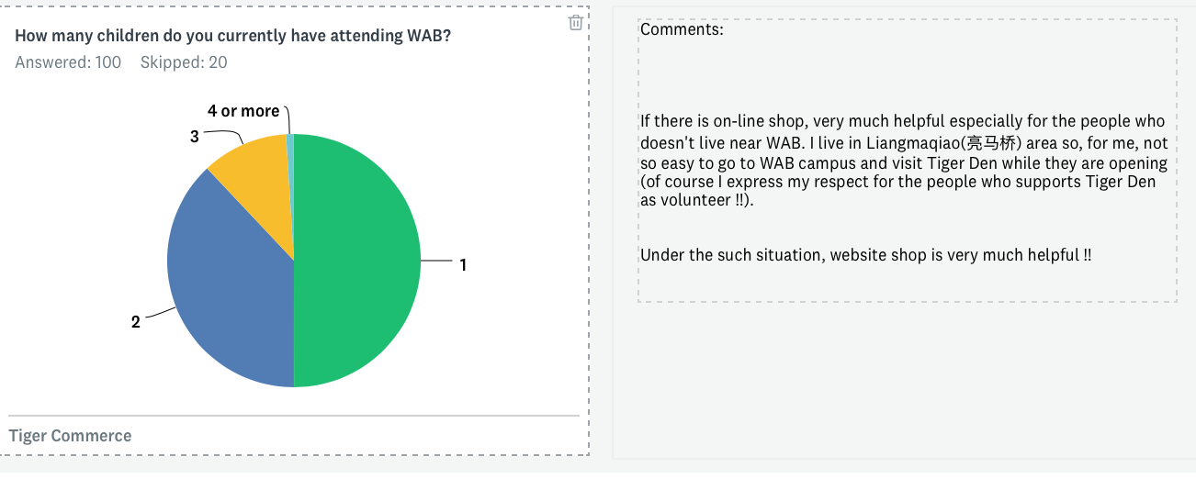
1. 71% of respondents have visited the Tiger Den.
2. 9% say that they are a ‘great deal’ familiar with the products available
3. 63% have made purchases from the Tiger Den.
4. 38% would definitely make a purchase online
5. 45% spend over RMB150 per year
6. 59% purchase each semester
3. The current situation
On-line Survey with 100 respondents who answered anonymously to a general call to answer 10 questions. Closed 12.09.2018

Slide 6
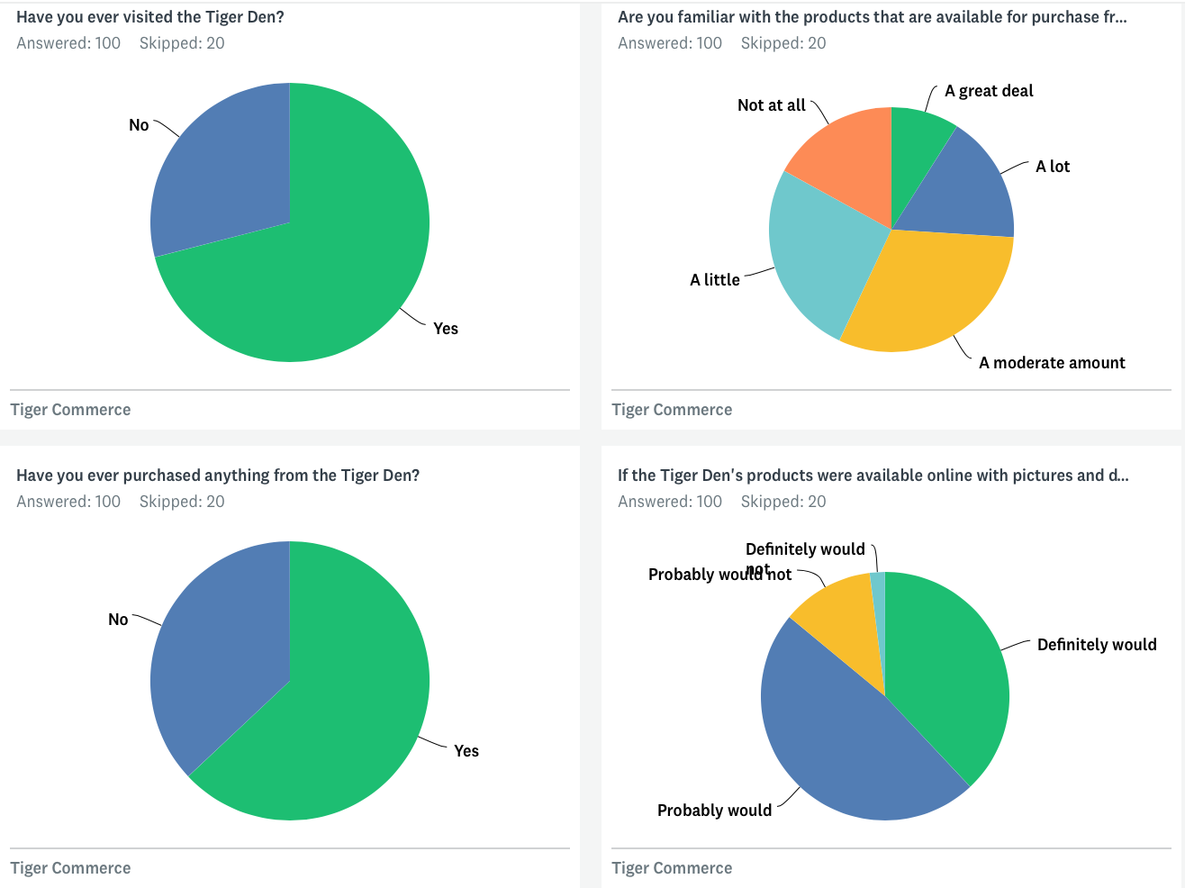
A demand for WAB merchandise availability both on and offline.
Survey with 100 respondents who responded to a general call to answer 10 questions.

Slide 7
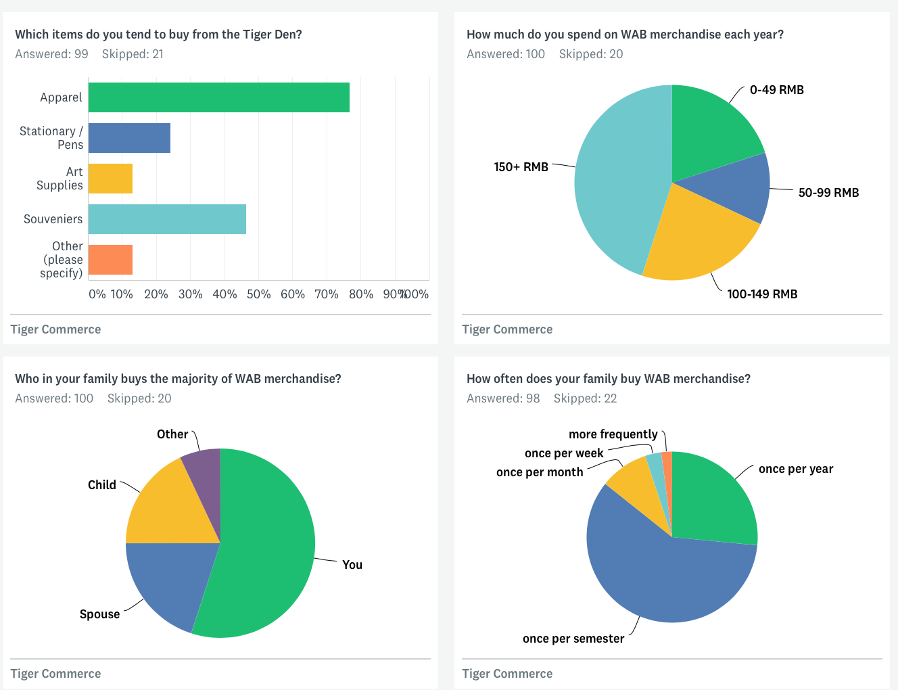
Tiger Den as key outlet for WAB apparel.
120 responded, only 100 answers shown due to software license restrictions.

Slide 8


WAB Tiger Merchandise
Currently the store sells:
- WABX apparel
- WAB marketing stock
- Student developed products.
- Cambridge Masks
Survey respondents also requested:(no order)
Umbrellas, decorations, decals. Folders. Highlighters. Caps. Wab polo tees, boxer shorts, tiger shark swimming trousers, T-shirt, socks, schoolbag, mac notebook cover, red fleece WAB blanket, pencil bag, WAB swimwear, WAB beanie for adults, USB’s, caps, coasters, drink coolers: the things you put your bottles or cans in to keep cool. Car stickers (bumper) screen shades for your car when parked, stationary, computer mouse, kites, vacuum mugs, posters, sports equipment, phone cases, battery packs, kit bags, re useable linen bags for shopping, elastic shoe laces, healthy snacks (granola bars), naming pen or pencils, merchandise for birthday presents, books, Winter Jacket, Stationary , toys,baggage tag, iPad covers.
And…
As a shop for all grades,I think we should have items according to them. And I think we should be better equipped. And one of the opinions of many is that the red notebook with the WABlogo is too expensive.
The old style thicker WAB PE pants for boys were very comfy in winter. New style (with tightening elastic at waist) are much less comfy. Black Lunch/snack box zippers break too easily.

Slide 9
Storefront - promotion

Slide 10
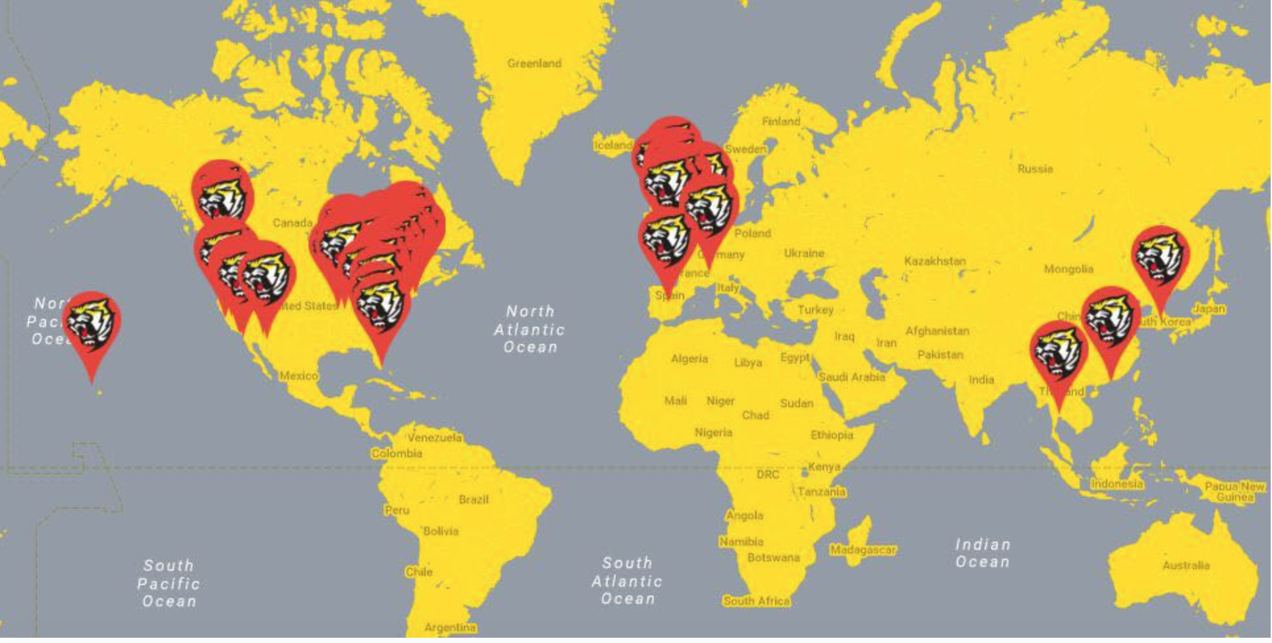
Target audience
The 5,000+ WAB Alumni Network (students & parents)
Potential market for WAB Tiger merchandise:

Slide 11
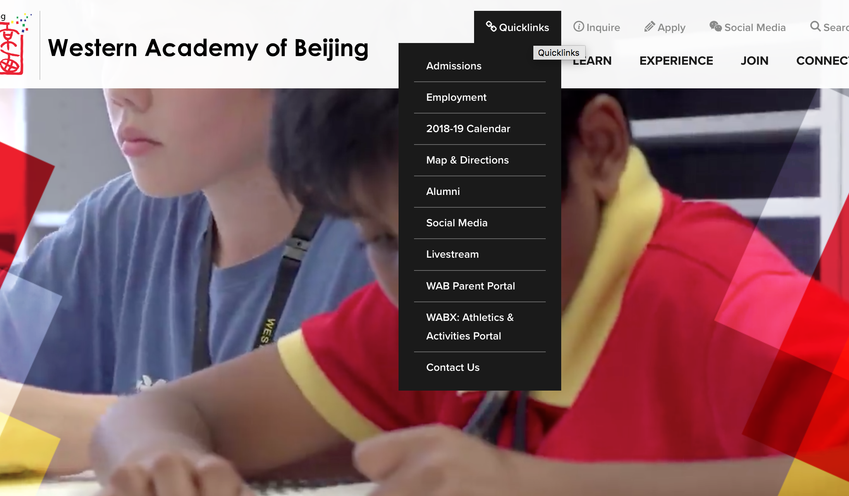
Easy to find the shop
Buy things
Can link to on-line store

Slide 12
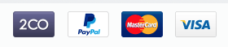
Internet shop http://wab.edu/shop

Slide 13
Merchandise selection
Sports kits
Food & beverage containers
Swim wear
Stationery & art supplies
Tickets to events

Slide 14
Features to consider
Storefront:
Professional themes available
Mobile commerce ready
Ability to brand the store
Ease of maintenance
Inventory system
Payment system
Use of own domain name e.g. WAB.shop.
Store:
SSL encryption
Credit card & alternative payment gateways e.g. wechat/alipay/paypal
Language
Backroom:
Integrated with shipping
Tax calculation
Fapiao generation
Store management:
Customer profile
Customer account creation
Fulfilment centre connection
Refunds
Email templates
Order fulfilment
Marketing: SEO optimised
Generate Site map automatically
Discounts across the platform
Gift cards
Social media integration
Product reviews by customers
Email marketing integration
Product:
Inventory management
Product variants
Product organisation e.g. category
Multiple images per product
Digital product direct download
Import/export csv
Analytics:
Dashboard
Product reports

Slide 15
4. Technology

Slide 16
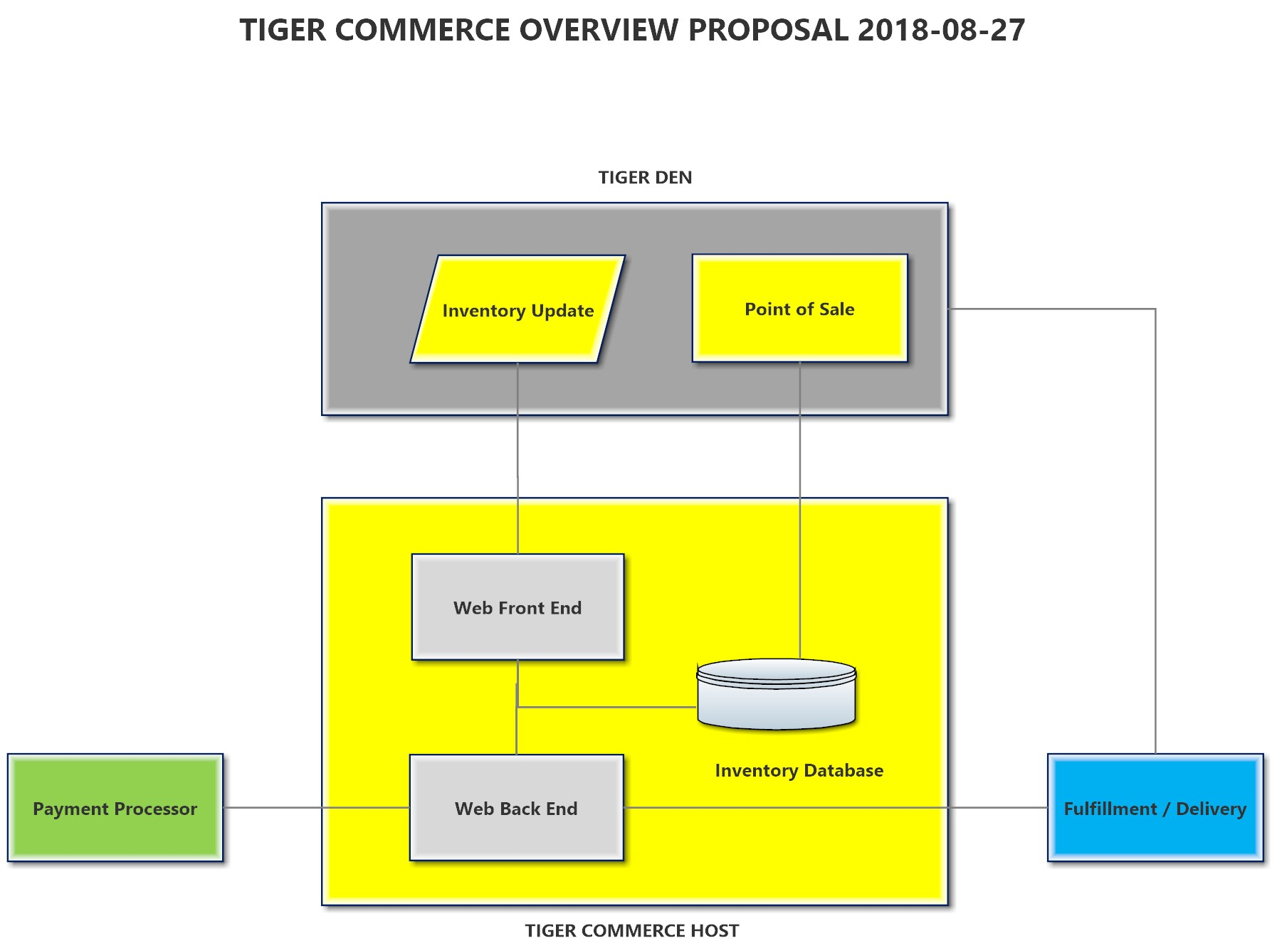
Technology overview

Slide 17
5. Legal

Slide 18
Parent Link runs the shop and future online sales of WAB Tiger Merchandise.
Parent Link does not have a legal entity.
WAB has to apply for the necessary licenses, bank accounts and legal documents. WAB is very supportive.
WAB has to approve this project.
WAB agrees to team up and there seem to be no legal nor financial veto’s from the school. However, no official decision has been made on the project.

Slide 19
6. Finance

Slide 20
Detailed budget
The Parent Link cash flow runs via the WAB financial system (profit centre).
Currently there is no visibility into the Tiger Den revenues.

Slide 21
Budget
Assume 1,000 students spend on average RMB150 per year in year one.

Slide 22
7. Promotion / marketing

Slide 23
Promotion of the store will be done via:
the shop/Tiger Den (maybe signs at MS and HS)
WAB weekly
Social media
Print advertising

Slide 24
8. Workflow
A) Ordering
Purchage to refill stock
Order
in shop
Product sold out
Check stock inventory
Checking online orders
Product available
Delivery to client
Stock
(shop and storage)

Slide 25
8. Workflow
B1) Suppliers (shop delivery)
Check stock inventory
Determine deficit item(s) and amounts
Order the items from supplier, i.e. WABX
Check correct delivery
Stock
(shop and storage)

Slide 26
8. Workflow
B2) Suppliers (direct shipment)
Give supplier detailed order information
Check correct delivery via track &trace
Check order

Slide 27
8. Workflow
C) Fulfillment (actions for Tiger Den volunteers)
Take the items out of the shop or the storage
Print out address of customer
Take the order
Collect all items
Package the items and send to express firm
Check delivery via Track and Trace.

Slide 28
Timeline
 | Phase I | Phase II | Phase III | Phase IV | Phase V | Phase VI
Planning | August
Agree Implementation | Sept
Approvals |  | Sept | Oct | Oct | Nov
Catalogue of merchandise | August | Sept
Selection of technology platform |  |  | Sept
Photography of merchandise |  | Sept | Sept | Oct
Upload of content |  |  |  | Oct
Design storefront |  |  | Sept | Oct
Trial purchases |  |  |  | Oct | Nov 4th
Connect to WAB site |  |  |  |  | Nov 11th
Soft Launch |  |  |  |  | Nov 25th
Full Launch |  |  |  |  |  | Dec 1st

Slide 29
10. Research and questions
Management of a virtual store is going to create more work outside of current office hours.
Identify skillsets required.
Full inventory of the Tiger shop required including cost price & sale price
Sales of inventory to be determined ie. best sellers
Which technology platforms to used
Who will be responsible for the development, management and marketing.
Financial expectations in terms of returns.
Who will choose the inventory to be sold
How will we manage fulfilment of the products sold
Payments & refunds & fapiao
The integration of the Tiger Den with Tiger Commerce

Slide 30
12. Team
(no order of preference)
Jim James - jimajames@icloud.com
Amity G6, Halo G3
Victor Wang - omnivic@gmail.com
Rob Hackett - rob@thaxra.com
Michael Christiansen - michael_christiansen@wab.edu
COO/CFO at WAB
Raja Magasweran - raja@america-china.com
Jesper Køpke – j.kobke@outlook.dk.
Henk Vermeulen - hcv@hcv-advies.nl

